Slide 1
Human Rights
Lesson 5

Slide 2
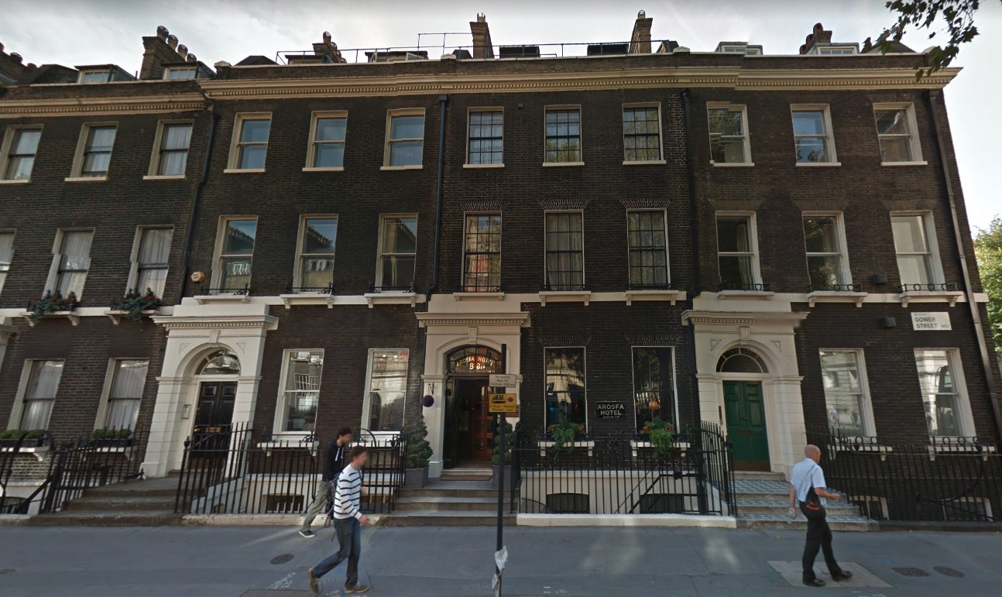

Slide 3
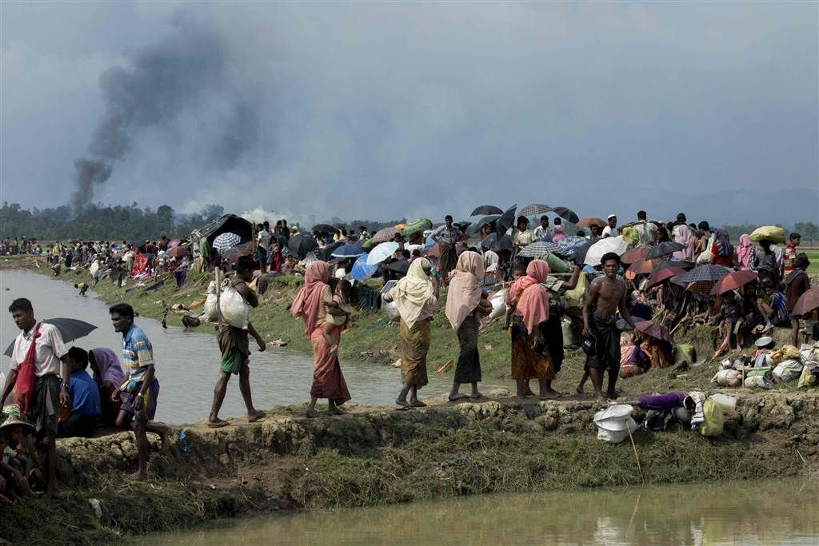
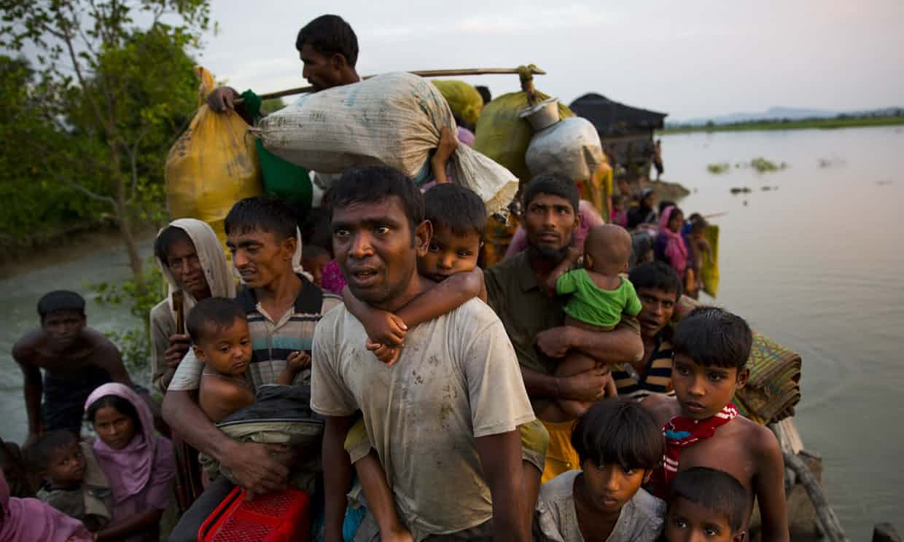

Slide 4
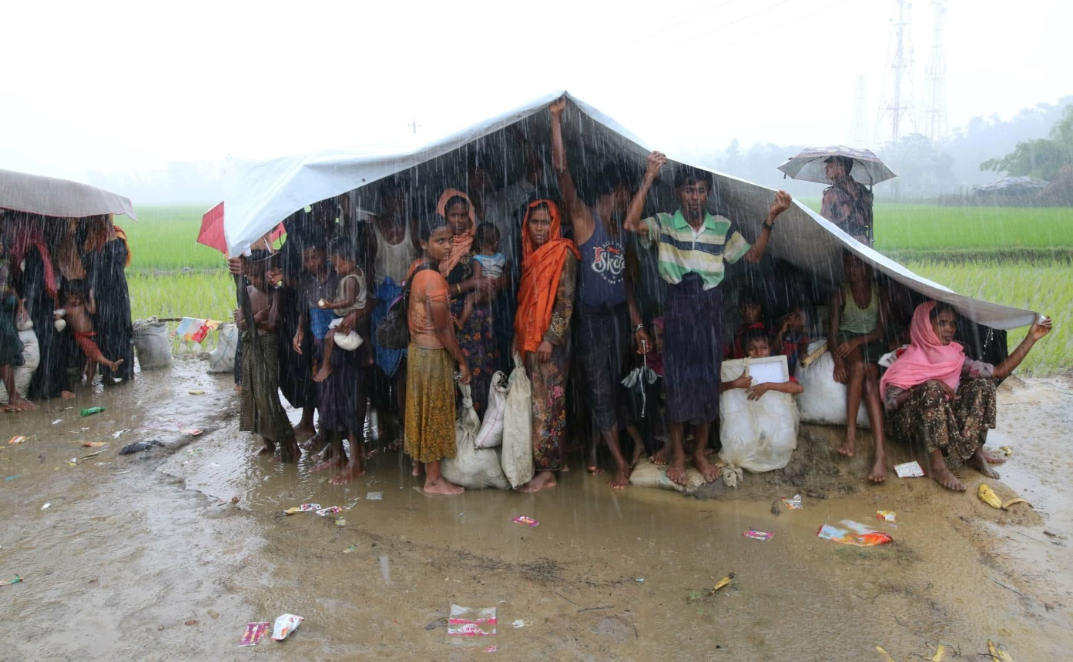
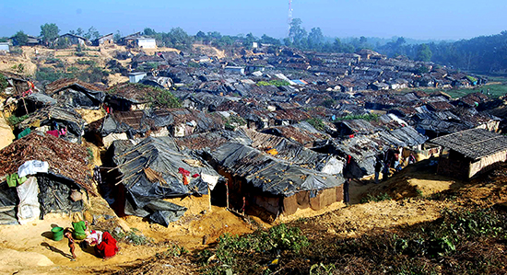

Slide 5
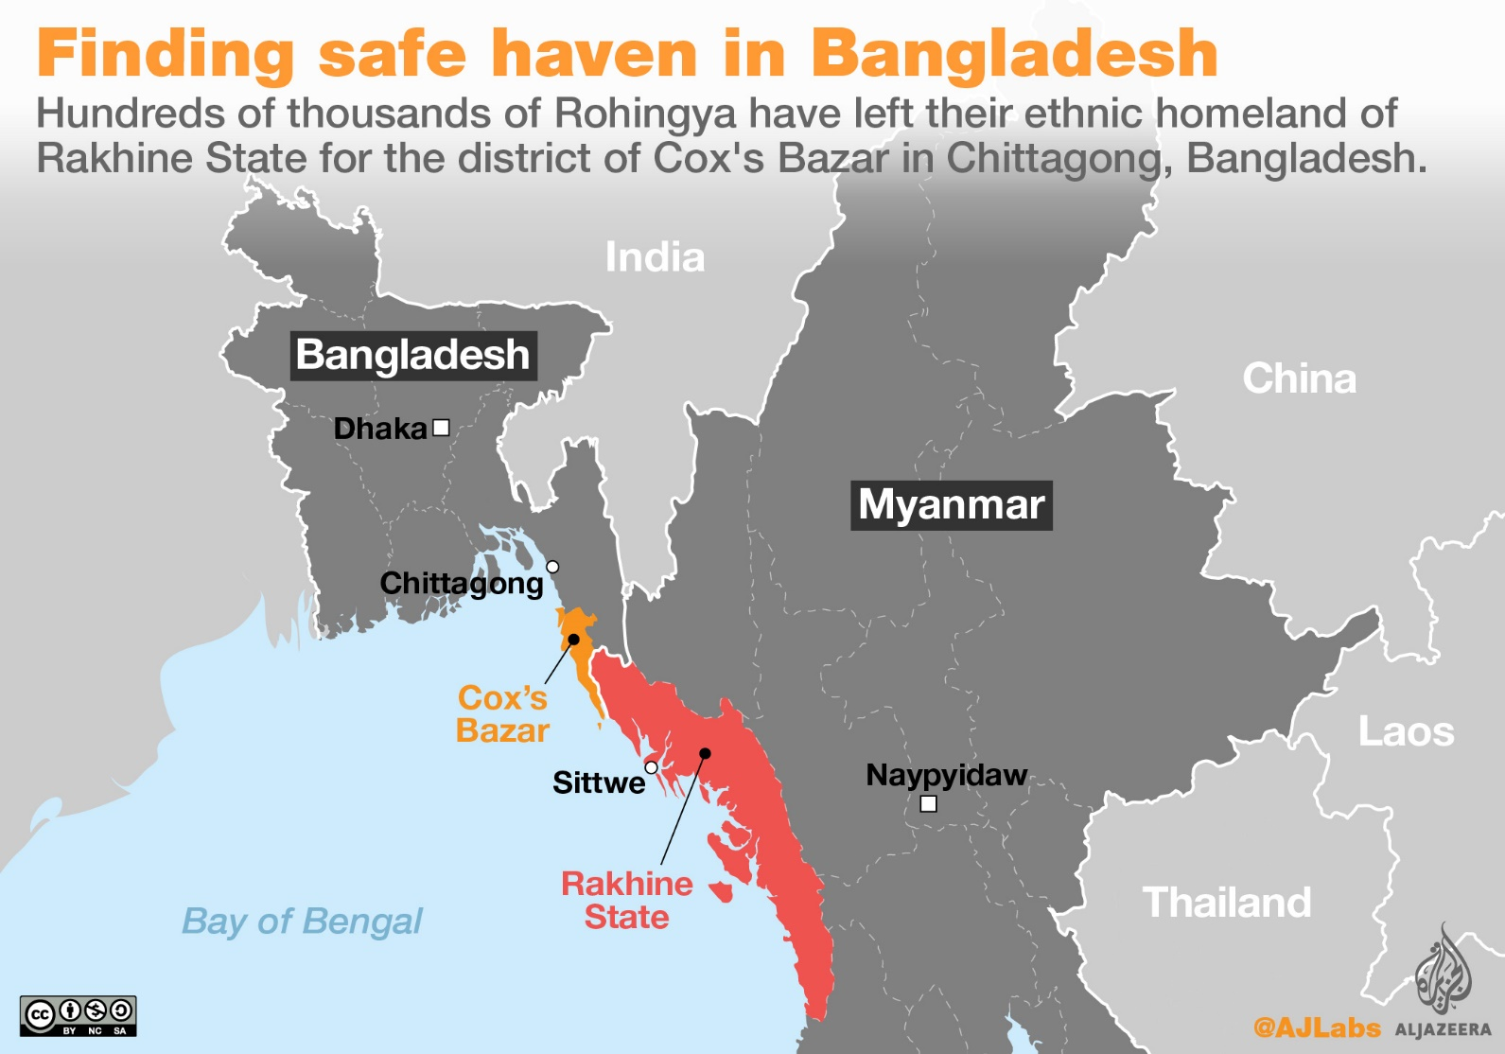

Slide 6
“Burma: Military Commits Crimes Against Humanity”
“Expulsions, Murder, Rape, Persecution of Rohingya”
“Since August 25, 2017, when the armed group the Arakan Rohingya Salvation Army (ARSA) attacked about 30 police outposts in northern Rakhine State, Burmese security forces have carried out mass arson, killing, rape, and looting, destroying hundreds of villages and forcing more than 400,000 Rohingya to flee to neighboring Bangladesh.”
Human Rights Watch https://www.hrw.org/news/2017/09/25/burma-military-commits-crimes-against-humanity

Slide 7
The Universal Declaration of Human Rights (UDHR)
UDHR is a declaration adopted by the United Nations General Assembly on 10 December 1948 in Paris, France.
Article 14
Everyone has the right to seek and to enjoy in other countries asylum from persecution.

Slide 8
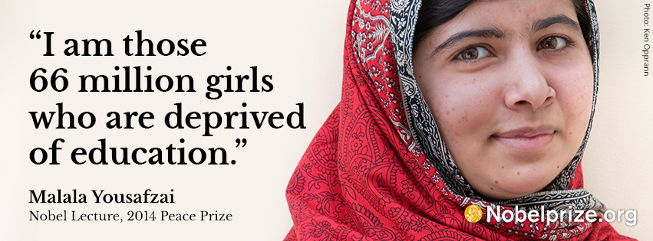
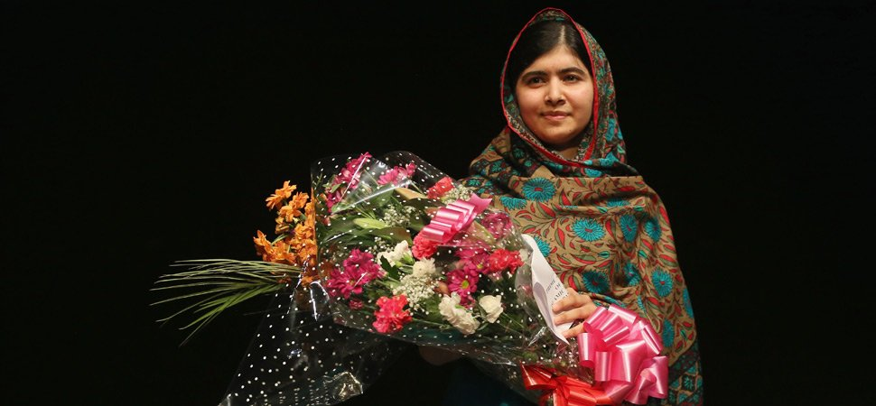

Slide 9
The Nobel Peace Prize 2014 Malala Yousafzai
“Many children in countries like Pakistan and India, as Kailash Satyarthi [another Nobel Peace Prize laureate in 2014] mentioned, many children, especially in India and Pakistan are deprived of their right to education because of social taboos, or they have been forced into child marriage or into child labour.”
https://www.nobelprize.org/nobel_prizes/peace/laureates/2014/yousafzai-lecture_en.html

Slide 10
Some facts about education in Pakistan
Only 18% of Pakistani women have received 10 years or more of schooling.
According to UNESCO figures, primary school enrollment for girls stand at 60 per cent as compared to 84 percent for boys.
The secondary school enrollment rate stands at a lower rate of 32 percent for females and 46 per cent males.
https://en.wikipedia.org/wiki/Education_in_Pakistan

Slide 11
Universal Declaration of Human Rights (UDHR)
Article 26
1. Everyone has the right to education.
Education shall be free, at least in the elementary and fundamental stages.
Elementary education shall be compulsory.
Technical and professional education shall be made generally available and
higher education shall be equally accessible to all on the basis of merit.

Slide 12
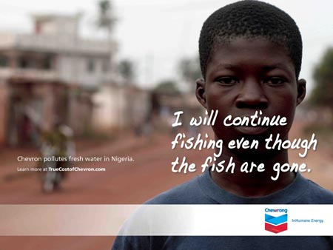

Oil giant Chevron
Chevron are accused of destroying the fish-stocks of
Nigeria through leaking toxic chemicals into the local fresh water lakes and rivers.

Slide 13

“Two men were killed and two were wounded by shots fired by troops summoned by Chevron’s Nigerian subsidiary on the fourth day of a confrontation with more than 100 villagers. Jurors [are] assessing …claims of assault, torture and wrongful death…”
(http://justiceinnigeria.wordpress.com/page/2/ )

Slide 14
Universal Declaration of Human Rights
Article 25
Everyone has
the right to a standard of living adequate for the health and well-being of himself and of his family, including food, clothing, housing and medical care and necessary social services, and
the right to security in the event of unemployment, sickness, disability, widowhood, old age or other lack of livelihood in circumstances beyond his control.

Slide 15

What are human rights?
“Human rights are fundamental rights which empower [i.e. give authority and power to] human beings to shape their lives with accordance to liberty, equality and respect for human dignity”
(NICE Education Manual, 2003)

Slide 16
Violation of human rights
The Rohingya refugees
No liberty
Unequal to the people of other ethnic groups in Myanmar
They have no citizenship and nationality.
No dignity
No security
Being brutally treated
Homeless
Some being separated from their families

Slide 17
Violation of human rights
Girls without education
No liberty
Social coercion and prohibition on girls’ education
Unequal
Unlike the boys who are given more educational opportunities
No dignity
Unable to read and write
Unable to develop their personality
Unable to determine their own life

Slide 18
Violation of human rights
Those people in Nigeria who suffered from the environmental hazards brought about by the oil giant
No liberty
To express their voice
Unequal to the multinational corporation
Chevron is protected by the government of Nigeria.
No dignity
Forced to live in poor natural and political environments that seriously affected their health and lives.
Insecure, no work

Slide 19
What is a right?
Having a right → can have a strong and legitimate claim
‘claim’ here = a demand or request for something considered one’s due.
E.g. if I claim a right to freedom of speech, I am asserting my legitimate claim against anyone who would prevent me from speaking out.
Having a right → someone has a duty or obligation to protect or respect that right
Vice versa? I might have a duty to develop my talents even though no one has a right that I do so.

Slide 20

Central features of human rights
1. Universal
They are meant for everyone, regardless of race, religion, ethnicity, nationality, age, sex, political beliefs (or any other kind of beliefs), intelligence, disability, sexual orientation or gender identity.
Note: Race is associated with biology, while ethnicity with culture, tradition, practice, and custom.
i.e.: We ALL have them.

Slide 21
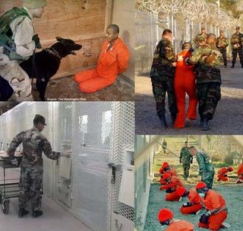
Central features of human rights
2. Unconditional
We have these rights unconditionally. We are owed them by the very nature of our humanity, no matter what.
Even terrorists or criminals should have equal rights (e.g., not to be tortured)!
The Guantanamo Bay detention camp

Slide 22
Central features of human rights
3. Inalienable
E.g. Right to life, right to liberty, and right to security, etc.
They are inherent rights that
must not be taken away
cannot be annulled or restrained by human laws
must not be overridden by any other interests (e.g. national security, economic growth, etc.).

Slide 23
Central features of human rights
4. Interdependent
Examples
the right to bodily integrity (including freedom of movement)
the right to freedom of assembly
the right to education
the right to a fair trial
the right to political participation
the right to food

Slide 24
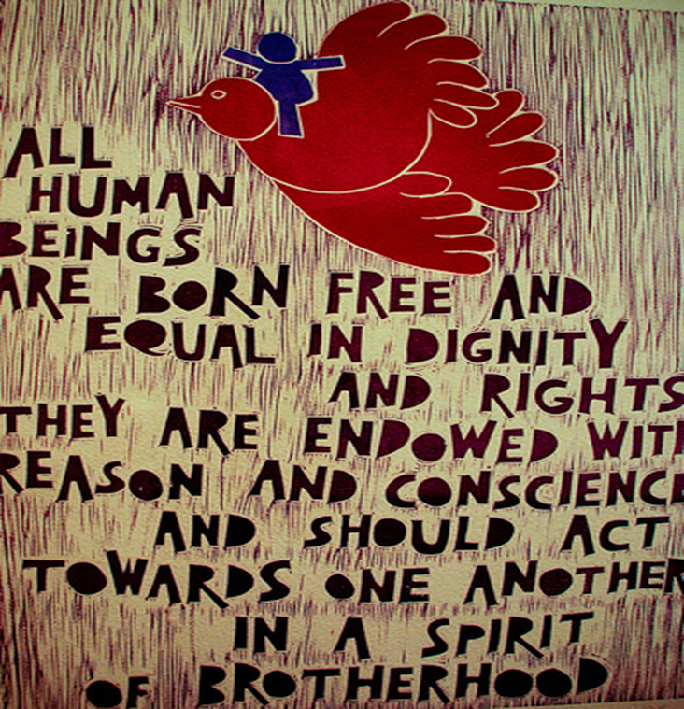

Slide 25
Where do Human Rights come from?
Universal Declaration of Human Rights
Drafted & adopted in 1948 in response to the horrors of WW2
Article 1 : “All human beings are born free & equal in dignity & rights...”
Preamble refers to the: “equal & inalienable rights of all members of the human family” &
the “equal rights of men & women”
Attempts to provide a universal framework for all societies regarding the basic rights of a human.

Slide 26
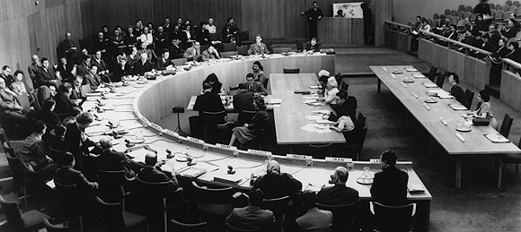
Drafting of the Universal Declaration of Human Rights – 1948, UN
UDHR lays down the fundamental rights:
To which every person is entitled (i.e. to have rights)
Which all national governments should strive to protect (i.e. have duties to protect the individuals’ rights)
Note: Although UDHR is an authoritative document, it has no legally binding force.

Slide 27
International human rights treaties
1966
International Covenant on Civil and Political Rights and
International Covenant on Economic, Social and Cultural Rights
More international laws on human rights
https://en.wikipedia.org/wiki/International_human_rights_law#International_Bill_of_Human_Rights
Note: Gradually there have been more and more treaties, covenants or conventions on human rights together with international courts or councils in different parts of the world – these international laws have binding force – setting the obligations for governments to follow.

Slide 28
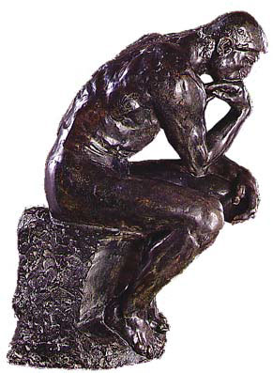
Philosophical views of Human Rights
We can see why we ought to have Human Rights, and how they have been argued as right through:
Deontology
(Kantian ethics)
Utilitarianism

Slide 29
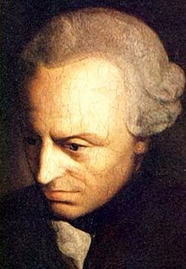
Justification of Human Rights: Deontology (Kantian ethics)
Respect humanity!!
UDHR – Article 1
“… [Humans] are endowed with reason and conscience and should act towards one another in a spirit of Brotherhood”
Categorical imperative (2nd formulation):
Treat persons as ends in themselves.

Slide 30
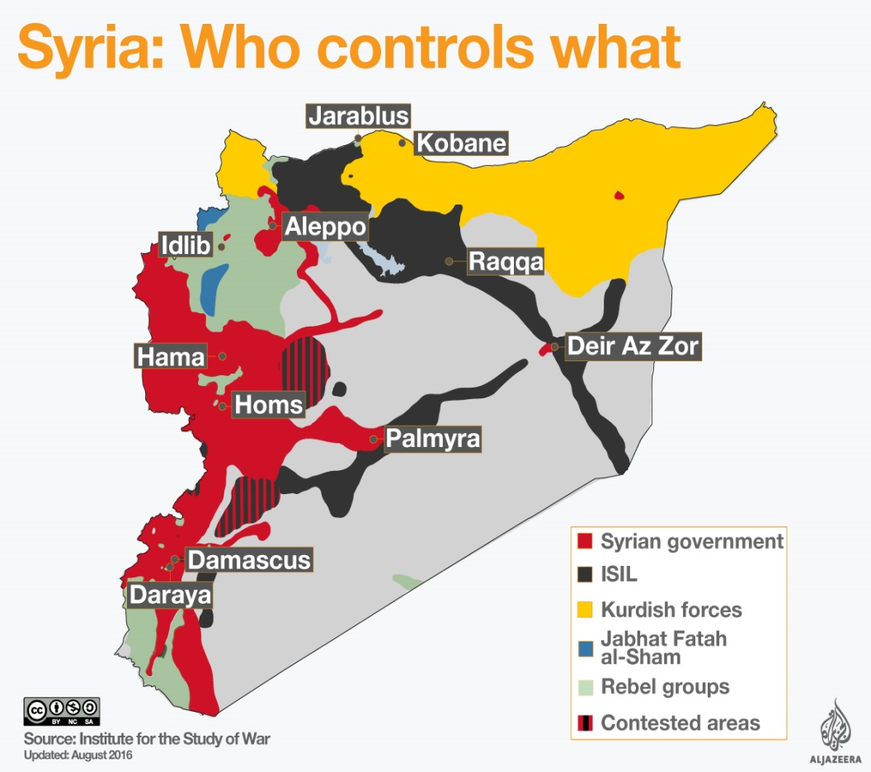
Justification of Human Rights: Utilitarianism
1. Stops Civil War
UDHR Preamble:
“Whereas it is essential, if man is not to be compelled to have recourse, as last resort, to rebellion against tyranny and oppression, that human rights should be protected by rule of law”
If human rights are not protected, then the consequences will be …

Slide 31

Justification of Human Rights: Utilitarianism
2. Stops International War
UDHR Preamble:
“Whereas it is essential to develop friendly relations between nations.”

Slide 32
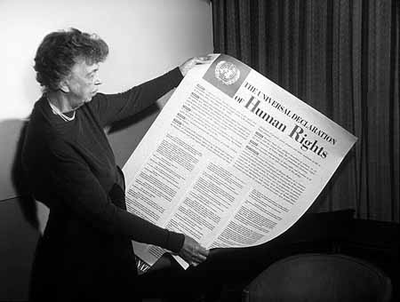
Do you know your Human Rights?
There are 30 Articles on the Universal Declaration of Human Rights, listing a large number of rights.
Conceptually, we can split them into 2 kinds:
1. Political and Civil Human Rights
Economic, Social and Cultural Human Rights

Slide 33
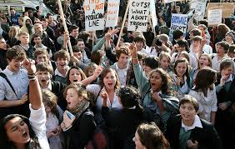
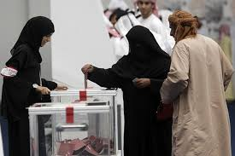
Political and Civil Human Rights
Bodily Integrity
Personal autonomy and self-determination over one’s body
Legal fairness
Freedom of thought, speech, assembly and association.
Political Participation
Note:
‘Civil rights’ are the rights of citizens to political and social freedom and equality.
PCHR are in general ‘negative’ rights, i.e., no interference from the government.
These rights are to be respected.

Slide 34
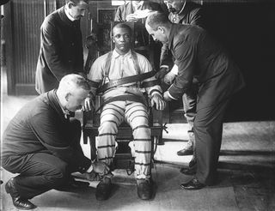
Bodily Integrity -- Life
Article 3:
“Everyone has the right to LIFE, LIBERTY and SECURITY of person”
Many argue that capital punishment violates this core human right.

Slide 35
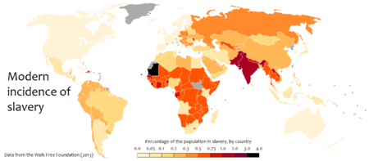
Bodily Integrity -- Slavery
Article 4
“No one shall be held in slavery or servitude, slavery and the slave trade are to be prohibited in all their forms.”

Slide 36
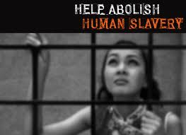
Human Trafficking and the sex trade
30 million women are trafficked and used as sex slaves across the world.

Slide 37
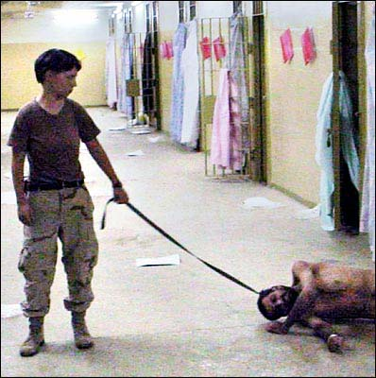
Bodily Integrity – No Torture
Article 5
“No one shall be subjected to torture or to cruel inhuman or degrading treatment or punishment.”
United States Army reservist Lynndie England was
convicted of torture and prisoner abuse at Abu Ghraib
In Baghdad, Iraq, in 2005

Slide 38
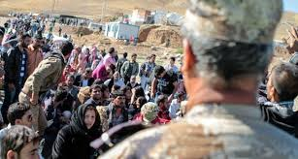
Bodily Integrity – Asylum
Article 14
“Everyone has the right to seek and enjoy in other countries asylum from persecution.”
Political refugees fled from Syria

Slide 39
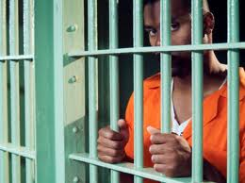
Legal Fairness
Articles 6, 7, 8, 9, 10, 11
Recognition by the law as
a person before the law
Equality before the law
Access to the law
No arbitrary arrest or detention
Innocent until proven guilty
Right to a fair, independent and public trial
Only guilty if the crime was against the law at the time

Slide 40
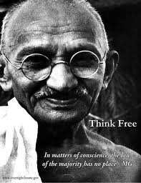
Freedom of Thought
Article 18
“Everyone has the right to freedom of thought, conscience and religion… and in public or private manifest his religion or belief in teaching, practice, worship and observance.”
Note: An individual need not follow the majority’s ways of life.

Slide 41

Freedom of Speech
Article 19
“Everyone has the right to freedom of opinion and expression …”

Slide 42
Freedom of assembly and association
Article 20
“Everyone has the right to freedom of peaceful assembly and association”
Presently in Fiji, under the Public Emergency decree in 2009, the state has the power to ban any and all assembly of peoples.
‘5:04 pm on 24 November 2016 Fiji agency says no to human rights march …
It says the Roads Authority described the march as unnecessary, causing traffic disruptions and an inconvenience to the people of Fiji.’
http://www.radionz.co.nz/international/pacific-news/318840/fiji-agency-says-no-to-human-rights-march

Slide 43

Political Participation
Article 15 – “Everyone has the right to a nationality.”
Article 21 – (3) “The will of the people shall be the basis of the authority of government; this will shall be expressed in periodic and genuine elections which shall be by universal and equal suffrage and shall be held by secret vote or by equivalent free voting procedures.”

Slide 44

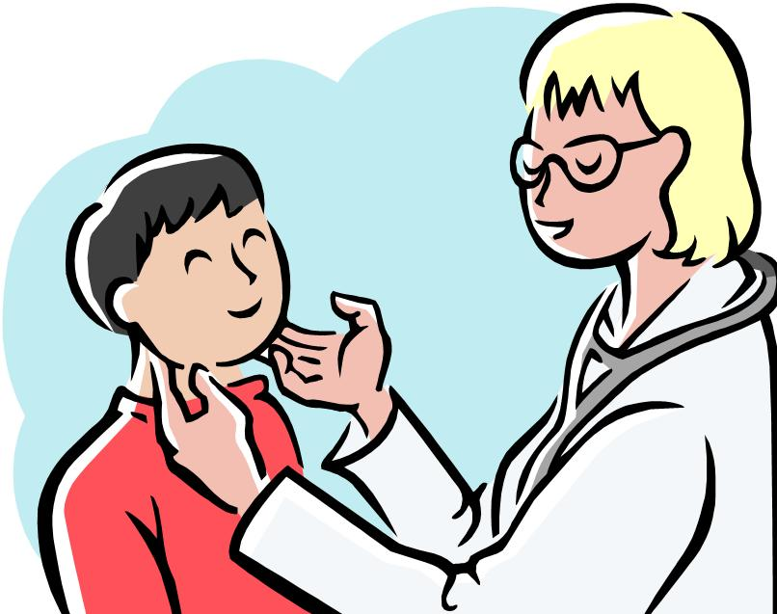
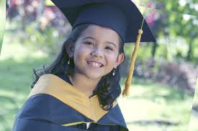

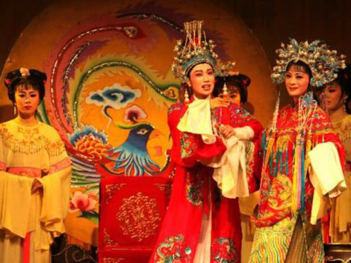
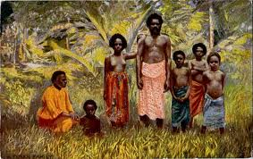
Do you know your human rights? Economic, Social and Cultural
Work
Health and Well-being
Education
Cultural life
Note: These rights are in general ‘positive’ rights (that the government has obligation to give, to fulfil (not only to respect).

Slide 45
Do you know your human rights? Economic, Social and Cultural
WORK - Articles 23 and 24
A right to work, to choose one’s employment and have favourable conditions of work
A right to equal pay for equal work
A right to just and favourable pay to ensure a life of dignity
A right to form and to join trade unions
A right to a (paid!) holiday

Slide 46
Health and Well being
Article 25
“Everyone has the right to a standard of living adequate for health and well-being of himself and his family, including food, clothing, housing, medical care and necessary social services, and the right to security in the event of unemployment, sickness, disability, widowhood, old age or other lack of livelihood…”

Slide 47
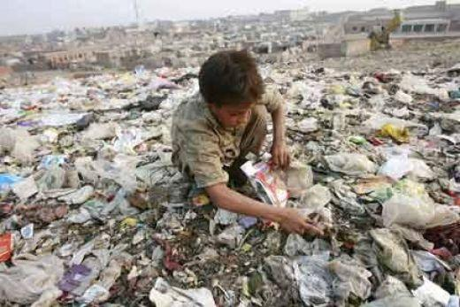
The right to food
In India
“In 2011, the National Food Security Bill, 2011, popularly known as Right to Food Bill was proposed.
In 2013, National Food Security Act, 2013 was passed by the Indian Parliament.
The Act guarantees subsidised food to 50% of the urban population and 75% of the rural population.”
https://en.wikipedia.org/wiki/Right_to_food_by_country

Slide 48
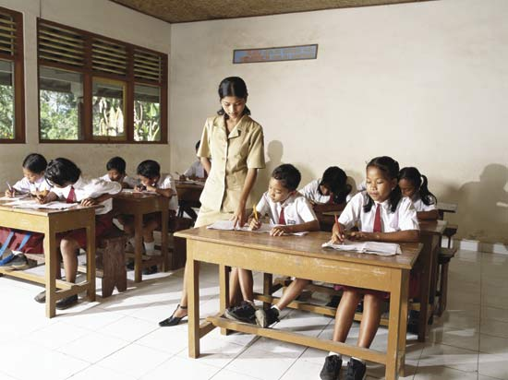
Education
Article 26
“Everyone has the right to education.”
Elementary education shall be free.
Elementary education shall be compulsory.
Higher education shall be accessible on the basis of merit.
It indicates one important purpose of education, among others:
“It shall promote understanding, tolerance and friendship amongst all nations, racial or religious groups…”

Slide 49
Collective rights
“Collective rights are held by a group, rather than any one individual.
The right to speak one’s native language and educate children in that language; the right to cultural preservation
Environmental rights to clean air, water, and land
The right to national self-determination
The right to development
The right to autonomous self-government for minority groups
…”
https://www.quora.com/What-are-collective-rights

Slide 50
Questions:
What happens when one Human Right clashes with another?
Do Human Rights put too much emphasis on the individual?

Slide 51
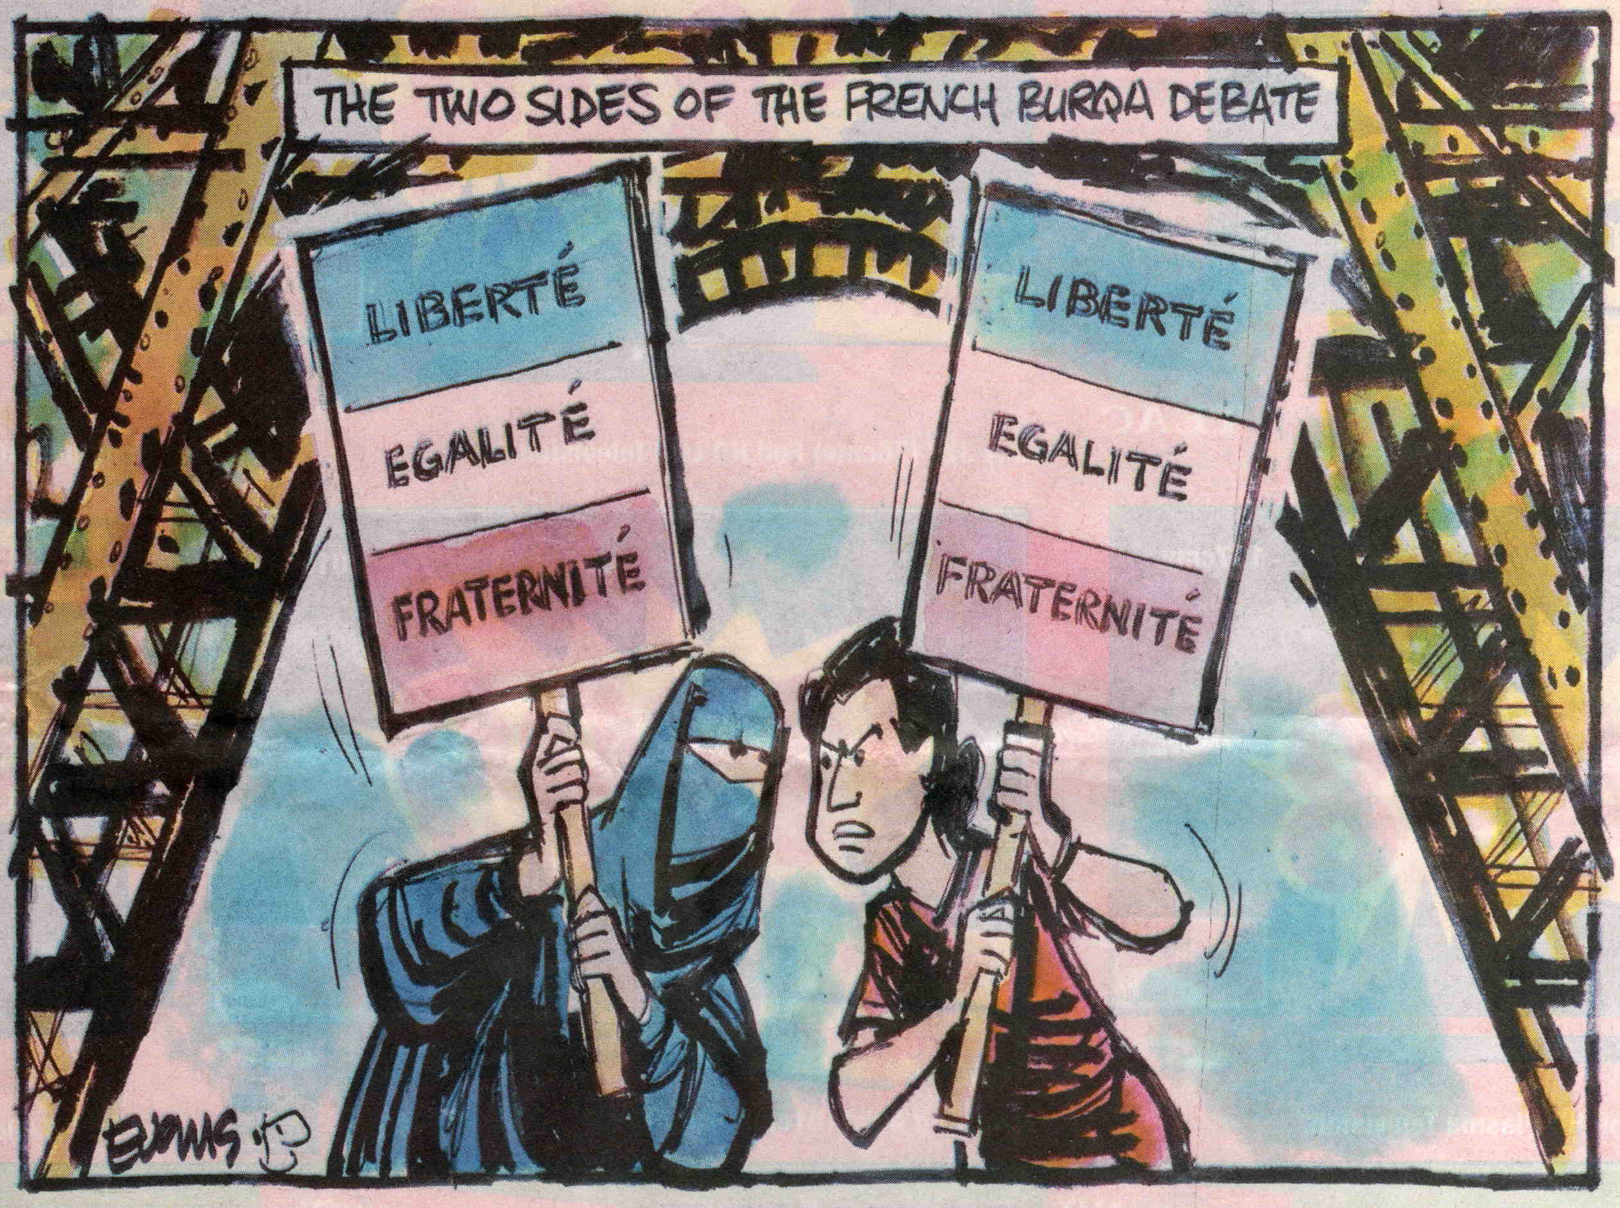
When human rights clash!

Slide 52
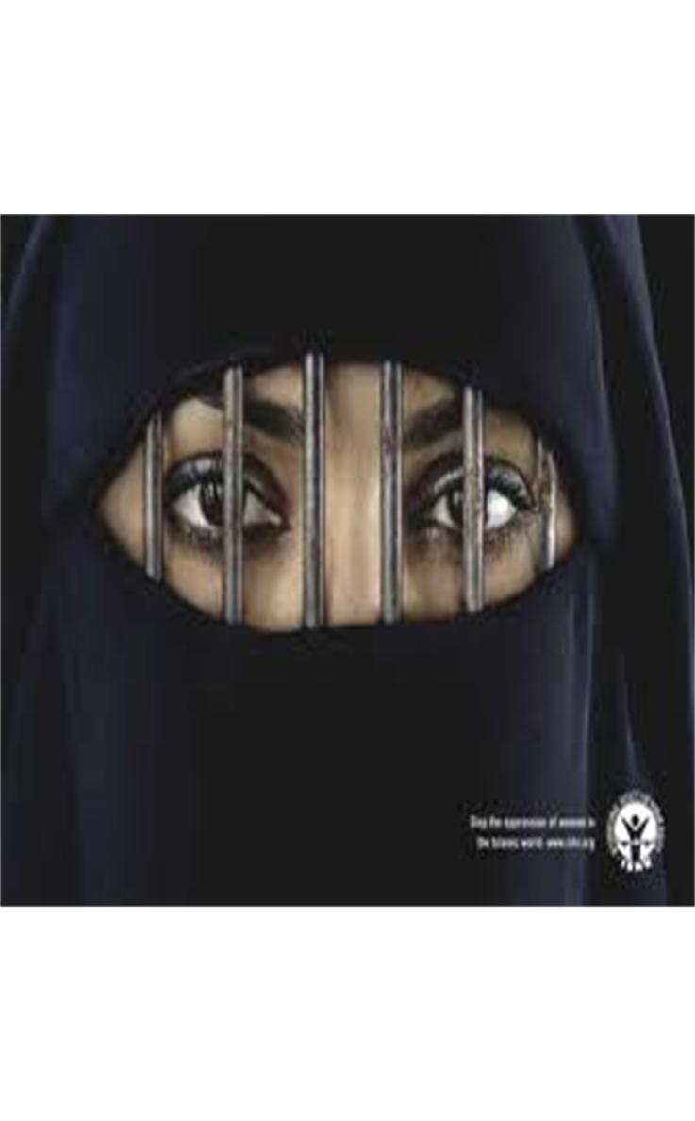

Slide 53
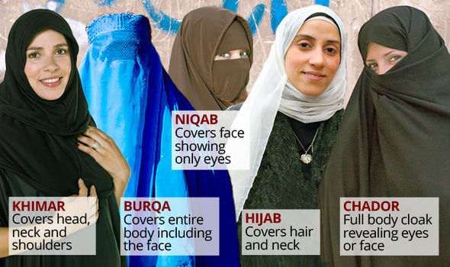
When Human Rights clash!
The burqas and niqabs have been banned in France since 2010 as it is seen as an insult to women’s dignity.
The Burqa covers Muslim women from top to toe, and is often equated with men’s domination over women, denying them access to wider society and forcing them to remain hidden.
It denies Muslim women their human right to participate in civil society as equal citizens.

Slide 54
Human Rights may clash!
However, some Muslim women feel that their religious and traditional identity is not respected.
They do not want a Western, modern, liberal woman’s identity. They argue their human right to religion is being violated.

Slide 55
The result in this case
“In 2014, the European Court of Human Rights upheld the French ban on burqa, accepting the argument of the French government that the law was based on ‘a certain idea of living together’". https://en.wikipedia.org/wiki/Burqa#France

Slide 56
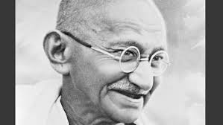
Don’t forget our duties!
Art.29
“Everyone has duties to the community in which alone the free and full development of his personality is possible”
Gandhi: “I learnt from my illiterate but wise
mother that all rights to be
deserved came from duty well
done. Thus, the very right to live
accrues to us when we
do the duty of citizenship to the
world.”
Mohandas Gandhi

Slide 57


Don’t forget other species and our planet Earth!
Protecting humans is of course very important, but does it invite us to under-value the non-human?

